Slide 1

SRI VASAVI ENGINEERING COLLEGE (AUTONOMOUS) (Sponsored by Sri Vasavi Educational Society) (Approved by AICTE, New Delhi & Permanently affiliated to JNTUK, Kakinada) Pedatadepalli, TADEPALLIGUDEM – 534101. W.G.Dist (A.P)
Design and Analysis of Sense Amplifier in a Pulse Generator of Cardiac Pacemaker using DVCCTA
Under the esteemed guidance of Project Associates
Mr. M. Pitchaiah, M. Tech 1. Ch. Sree Deepak (20A81A1403)
Asst. Professor 2. M. Chaitanya Komali (20A81A1432)
3. G. Bhargavi (21A85A1401) 4. J. Nanaji (21A85A1402) 5. P. Naveen (21A85A1405)
Date: 23-04-2024

Slide 2
CONTENTS
ABSTRACT
OBJECTIVE
PROBLEM STATEMENT
INTRODUCTION
LITERATURE SURVEY
EXISTING DESIGN
PROPOSED DESIGN
APPLICATIONS & ADVANTAGES
CONCLUSION & FUTURE SCOPE
REFERENCES

Slide 3
ABSTRACT
Cardiac Pacemakers play a vital role in the emerging medical field, as people are suffering from arrhythmia this pacemaker helps in monitoring cardiac activity.
The Pulse Generator is the heart of the Pacemaker which comprises of sense amplifier, timing unit, and logic control unit.
Sense amplifiers can be designed using an analog active block DVCCTA (Differential Voltage Current Conveyor Transconductance Amplifier).
The DVCCTA comprises the advantages of both the active blocks DVCC and OTA.
The sense amplifier consists of an instrumentation amplifier, band pass filter, and comparator that are used to detect the R wave from the cardiac signal.
Based on the sense amplifier's output the timing and logic control unit decides whether pacing to be done or not.
This can be stimulated with the help of Cadence using TSMC180nm technology.

Slide 4
OBJECTIVE
To create a robust sense amplifier using DVCCTA technology for precise R wave detection in a pacemaker's pulse generator. Employ Cadence Virtuoso 180nm technology to optimize design and simulation, aiming to improve arrhythmia monitoring and pacing accuracy.

Slide 5
PROBLEM STATEMENT
Design Sense Amplifier in cardiac pacemaker using DVCCTA over conventional op-amp addresses the arrhythmia. This problem statement focuses on developing a design that optimizes power consumption, high operating frequency, large dynamic range and electronic tunability.

Slide 6
INTRODUCTION
In today's world, several million patients rely on implantable medical electronic devices (IMEDs) like cardiac pacemakers which are extensively used during serious illnesses like arrhythmia.
This pacemaker plays a key role in monitoring cardiac activity and helps in controlling the pacing.
Pacing is of two types fixed pacing and demand pacing.
In fixed pacing internal activity of the heart is not considered, whereas in demand pacing sense amplifier determines the internal activity of the heart.
Based on sense amplifier’s output QRS complex signal pacing is done.
Sense Amplifier is designed using current mode analog active block DVCCTA which has an added advantage of electronic tuning.

Slide 7
LITERATURE SURVEY
Year | Authors | Paper Title | Implementation
2023 | Pavan Kumar Bikki, Yenduri Dhiraj, R.V.S.Nivas Kumar | Design and Implementation of Sense Amplifier in a Pulse Generator of Cardiac Pacemaker | Implementation of instrumentation amplifier, band pass filter and a comparator using Differential Voltage Current Conveyor analog active block
2023 | H. Pamu, K. K. Puli and K. K. Gurrala | A novel DVCCTA based Electronically tunable Instrumentation Amplifier | Implementation of an instrumentation amplifier using Differential Voltage Current Conveyor Trans conductance analog active block

Slide 8
2021 | Shankar, Chandra & Singh, S. & Imam, Raza | SIFO–VM/TIM universal biquad filter using single DVCCTA with fully CMOS realization | Implementation of a single input five output bi-quad filter using Differential Voltage Current Conveyor Trans conductance analog active block
2019 | John Vista, Nonglen Meitei Pheiroijam, Harika Pamu, Huirem Tarunkumar & Ashish Ranjan | A Novel Differential Voltage Current Conveyor (DVCC) Based Instrumentation Amplifier | Implementation of an instrumentation amplifier using Differential Voltage Current Conveyor analog active block

Slide 9
BASE PAPER
https://doi.org/10.1142/S0218126623501487
In this paper sense amplifier in a cardiac pacemaker is designed using a DVCC active block.
The two significant aspects of pacemakers are sensing and pacing.
The purpose of this study is to develop a model that can describe the function of pacemaker in real-time.
SOFTWARE USED:
Sense amplifier is designed with the technology of 180nm with DVCCTA active block it used Cadence virtuoso in the front end and Xilinx in the back end.

Slide 10
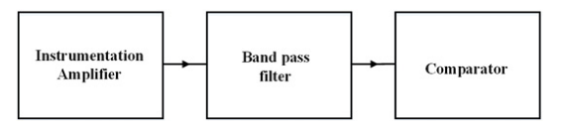
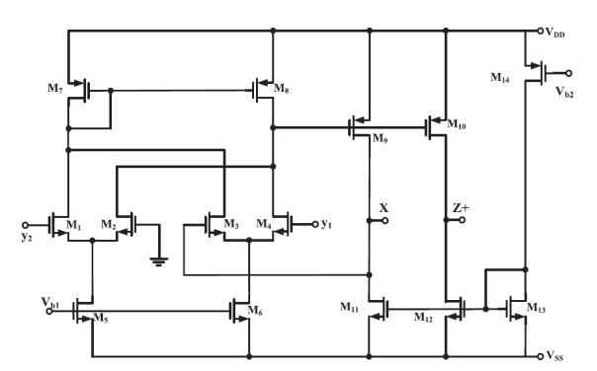
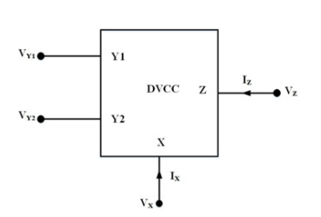
EXISTING METHOD
Sense amplifier was designed using conventional op-amp and DVCC which has more power consumption and low operating frequency.
Fig. 1. Block diagram of Sense Amplifier
Fig. 2. DVCC block
Fig. 3. DVCC internal structure

Slide 11
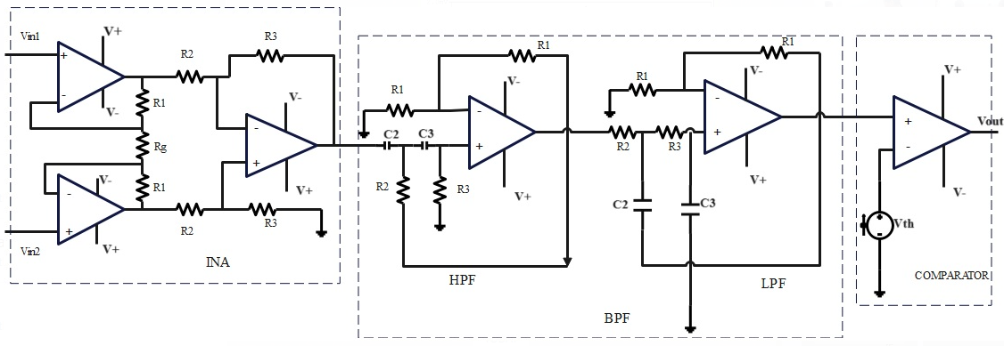
IMPLEMENTED DESIGN (CONVENTIONAL OP-AMP)
Fig. 4. VOA-based Sense Amplifier

Slide 12
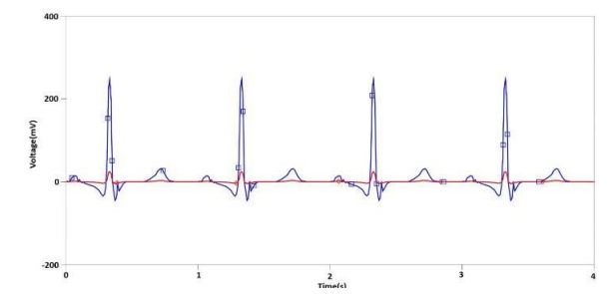
OUTPUT WAVEFORMS
Fig. 5. ECG Test input at INA
Fig. 6. Output of INA

Slide 13
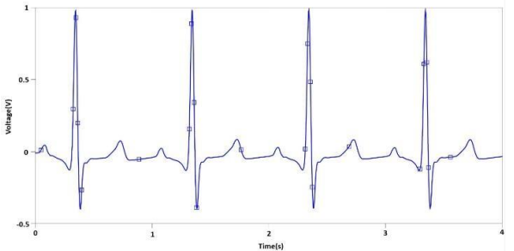
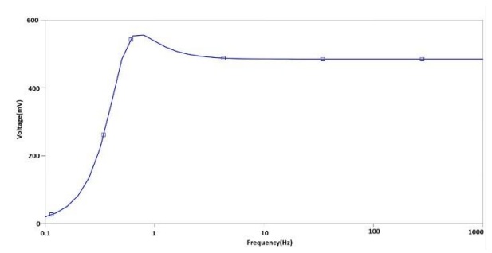
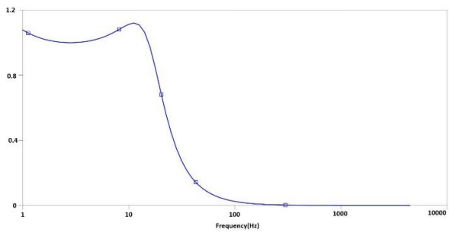
Fig. 7. Transient Response of BPF
Fig. 8. AC Response of HPF
Fig. 9. AC Response of LPF

Slide 14
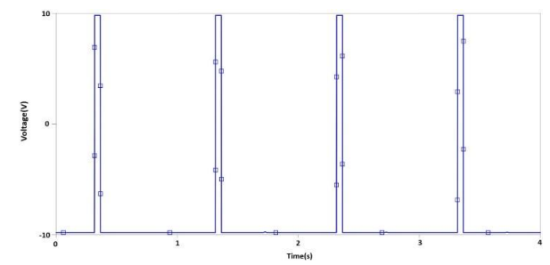
Fig. 10. Final Output at Comparator

Slide 15
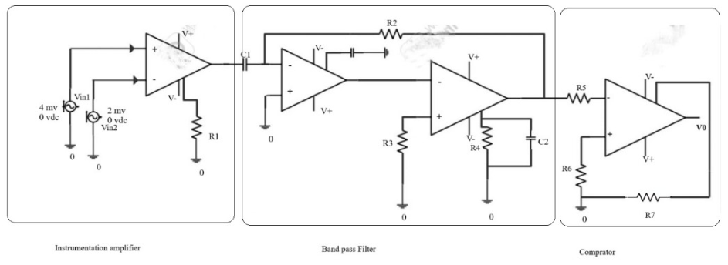
IMPLEMENTED DESIGN (CFOA)
Fig. 11. CFOA based Sense Amplifier

Slide 16
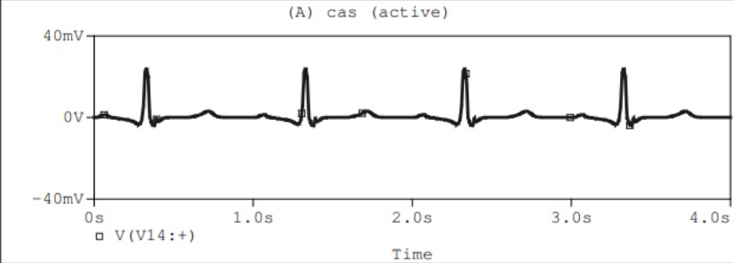
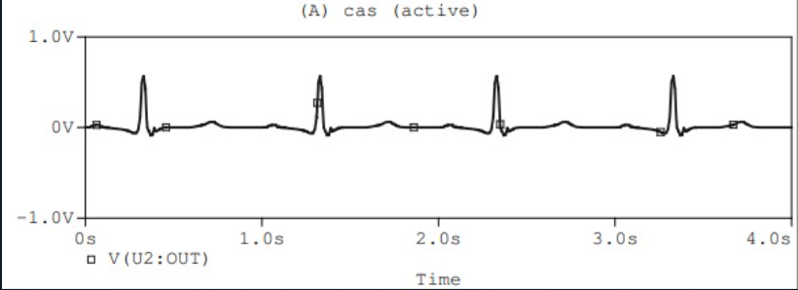
OUTPUT WAVEFORMS
Fig. 12. Input of CFOA INA
Fig. 13. Output of CFOA INA

Slide 17
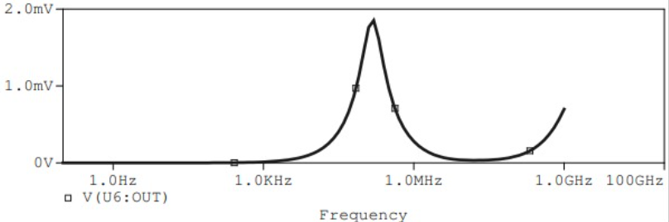
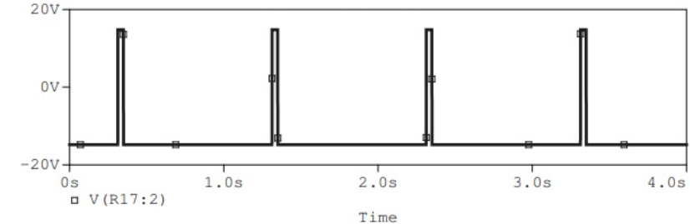
Fig. 14. Output of CFOA BPF
Fig. 15. Final Output at Comparator

Slide 18
VOA vs CFOA
VOA
CFOA
Complex circuit design
More power consumption
Low slew rate of 0.5V/usec
Conflict of gain bandwidth product
Ex:LM741
Simple circuit
Low power consumption
High slew rate of 2000V/usec
Gain bandwidth decoupling
Ex: AD844

Slide 19
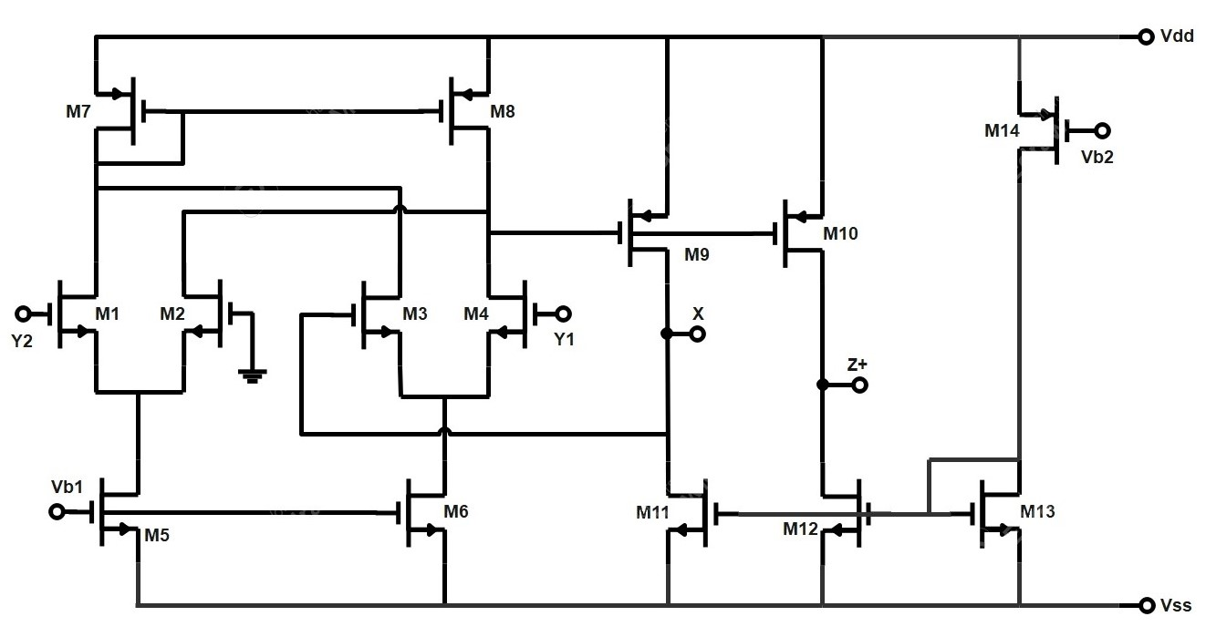
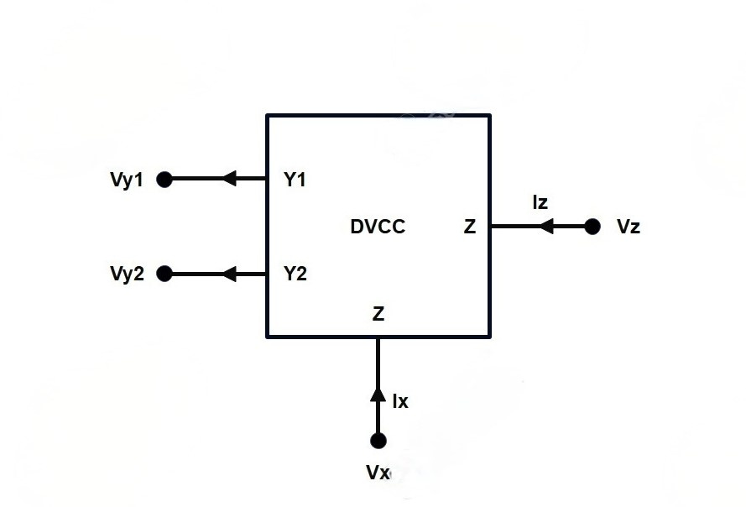
Implemented Design (DVCC)
The Differential Voltage Current Conveyor is one of the Active Analog Block which is used to realize the Circuitry like Comparator, Filters etc. Due to its Electronic Tunability, Higher Slew Rate and Higher Band Width. These analog blocks are widely used to realize the circuits like Comparators, Filters, Instrumentation Amplifiers etc.
Fig. 16. CMOS Implementation of DVCC
Fig. 17. DVCC Block Diagram

Slide 20
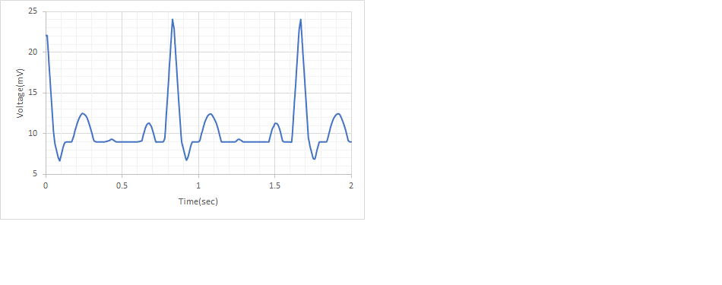
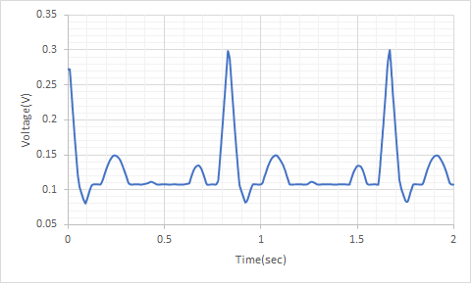
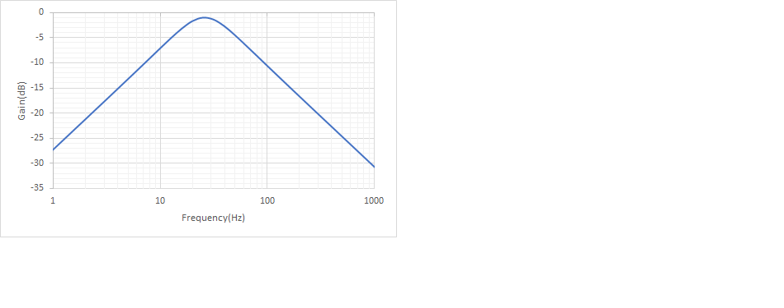
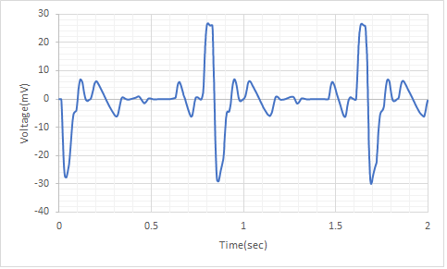
OUTPUT WAVEFORMS
Fig. 18. Input ECG Signal
Fig. 19. Output of INA
Fig. 20. Magnitude Response of Band Pass Filter
Fig. 21. Output of the Band Pass Filter

Slide 21
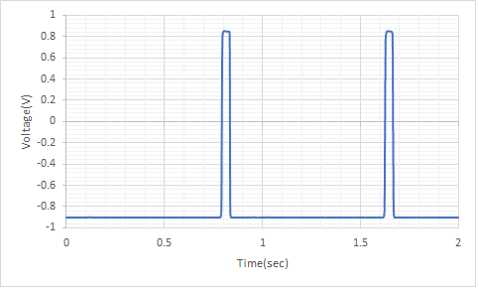
OUTPUT WAVEFORMS
Fig. 22. Output of Sense Amplifier

Slide 22
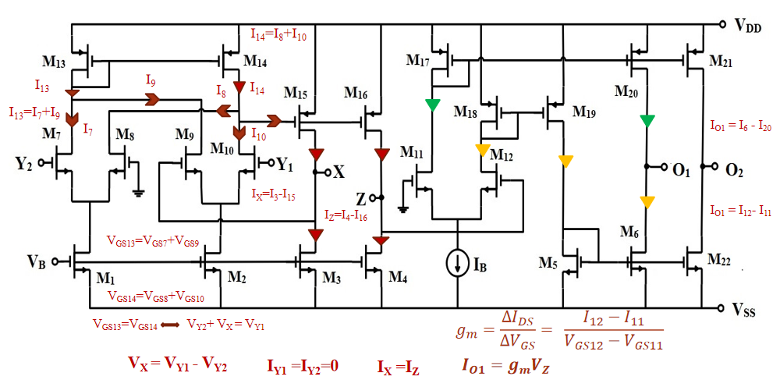
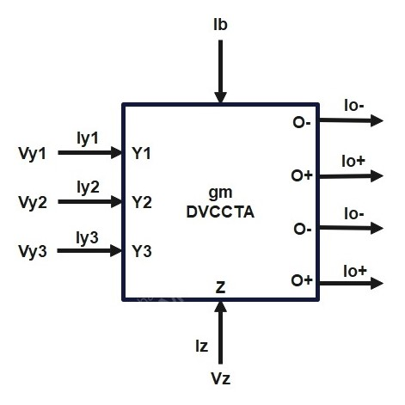
PROPOSED DESIGN:
The DVCCTA, a simple active block that is a combination of DVCC resides at the input phase and OTA remains at the output phase. This project further can be implemented using DVCCTA which is a combination of DVCC and OTA analog active blocks which provides electronic tuning.
Fig. 24. DVCCTA block
Fig. 23. Implementation of DVCCTA

Slide 23
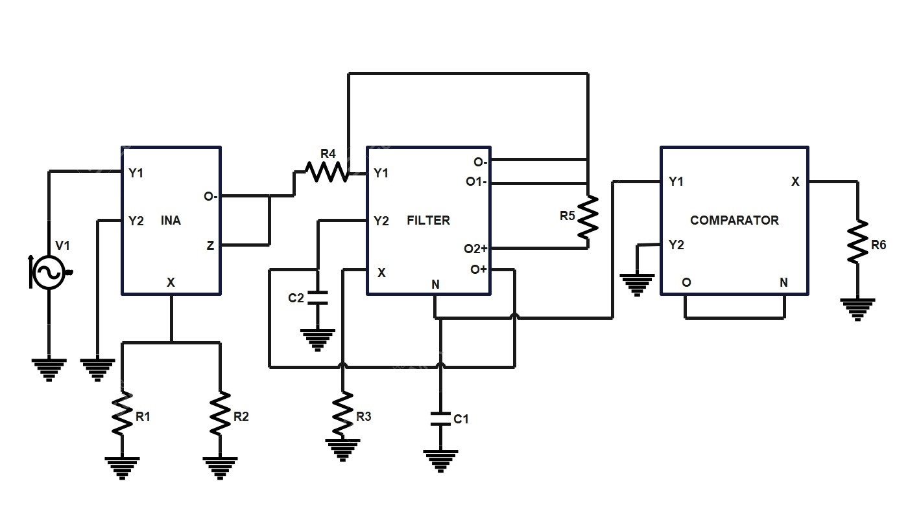
Block Diagram (DVCCTA Sense Amplifier)
Fig. 25. Block Diagram of DVCCTA Sense Amplifier

Slide 24
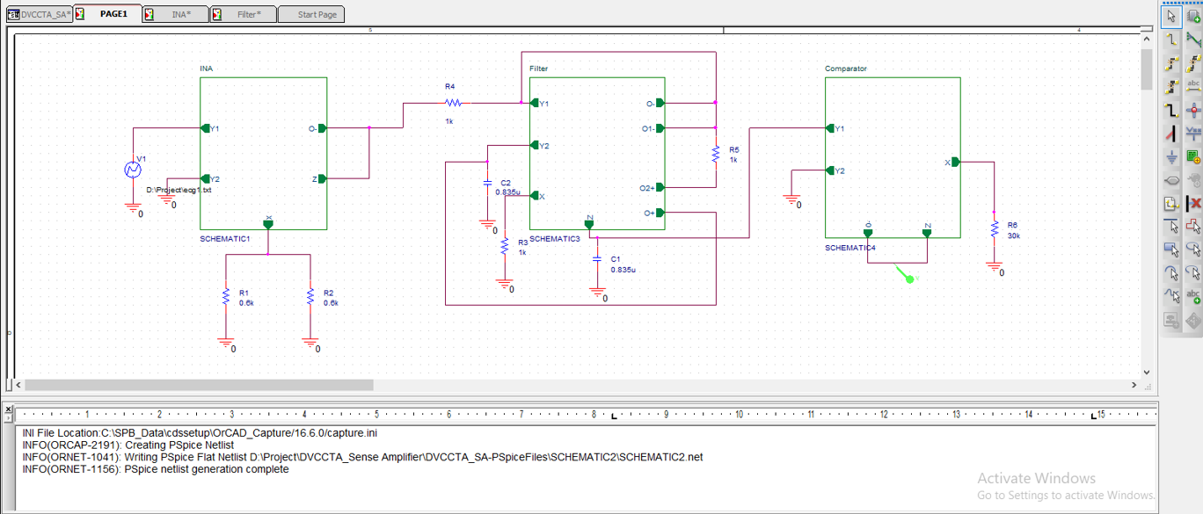
Practical Implementation of DVCCTA Sense Amplifier

Slide 25
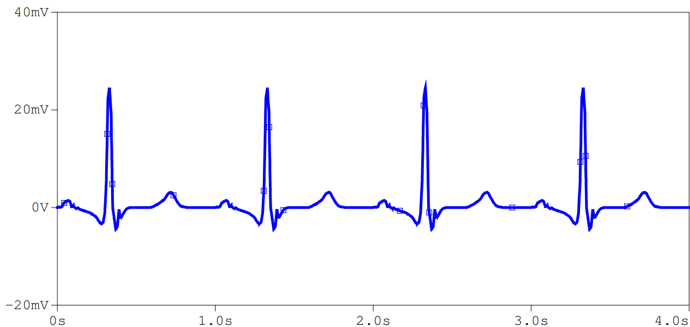
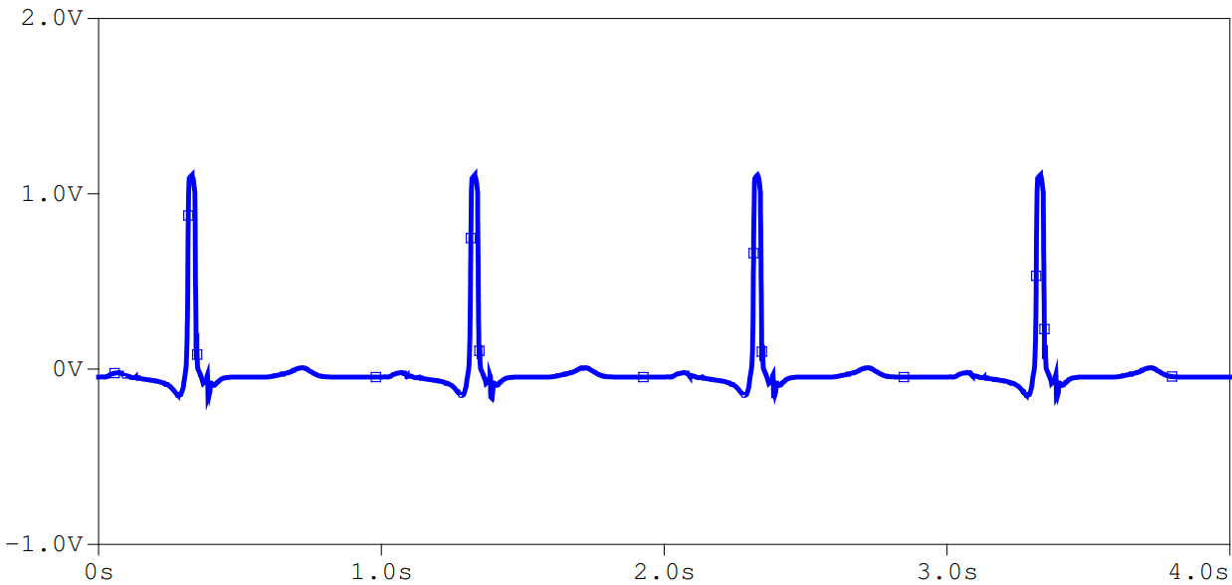
OUTPUT WAVEFORMS
Fig. 26. Input of INA
Fig. 27. Output of INA

Slide 26
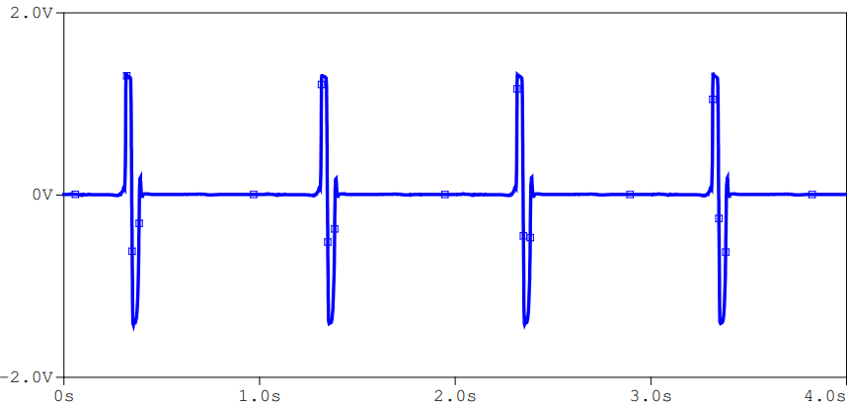
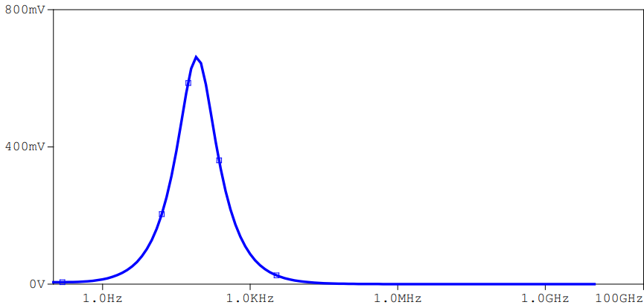
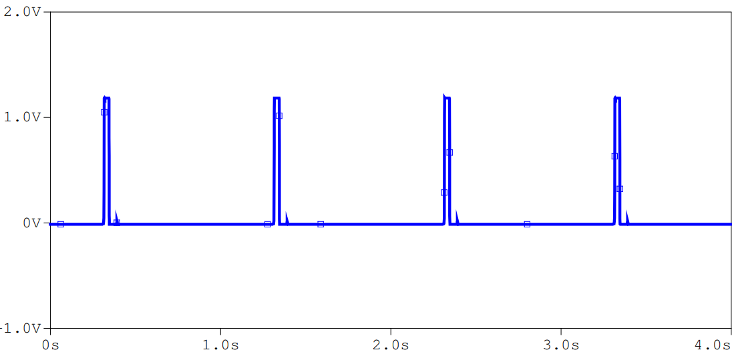
OUTPUT WAVEFORMS
Fig. 28. Output of Band Pass Filter
Fig. 29. AC Response of Filter
Fig. 30. Output of Comparator

Slide 27
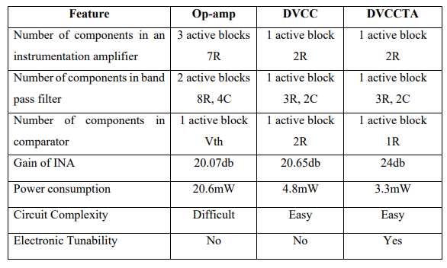
COMPARISON OF VOA vs DVCC vs DVCCTA

Slide 28
APPLICATIONS
Medical field
ADVANTAGES
Low power consumption
High Slew rate
Large dynamic range
High operating frequency
Better linearity and accuracy
Simple circuit structure

Slide 29
CONCLUSION & FUTURE SCOPE
The motive of this work is to develop a model that can depict the functionality of a real time Cardiac Pacemaker.
This is a device which has many critical parameters and their improper tuning may be life threatening.
The front end design of the Sense Amplifier has been implemented in Cadence using TSMC 180 nm technology.
The simulations have been generated and verified with the real time behavior. A power reduction of about 10 times has been observed with the DVCCTA based Sense Amplifier compared to that of the Op-amp based sense amplifier and DVCC based sense amplifier.

Slide 30
This DVCCTA is an analog active block which comprises the features of two blocks DVCC and OTA.
The OTA has a special feature of electronic tunability by tuning the bias current (IB) and trans conductance (gm) can have control over the gain.
The advancement in the VLSI technology is largely helpful in scaling of the device to achieve much more efficiency.

Slide 31
FUTURE SCOPE
Implement the peripheral for the transmission of the data related to the pacing.
Integrating the front end and back end in a single integrated unit.
Real time implementation by using FPGA.
Dual Sensor Approach for the rate responsive pacing and further optimization of the algorithms.
Optimize the power dissipation by reducing it.

Slide 32
REFERENCES
https://doi.org/10.1142/S0218126623501487
[1] Barrow IN, “The heart cycle: review.” MOJ Womens Health. 2019;8(1):66‒69. DOI: 10.15406/mojwh.2019.08.00214
[2] S. A. P. Haddad, R. P. M. Houben and W. A. Serdijin, "The evolution of pacemakers," in IEEE Engineering in Medicine and Biology Magazine, vol. 25, no. 3, pp. 38-48, May-June 2006, doi: 10.1109/MEMB.2006.1636350
[3] Atul Kumar Sharma, Raghuvendra Pratap Tripathi, Dinesh Bhatia, Sudip Paul, Nitin Sahai, T. K. Sinha. "The Evolution and Advancement of Pacemaker Technology" International Journal of Computational Engineering Research, July-2018

Slide 33
[4] Abhipsa Panda. "VLSI Implementation of a Demand mode Dual Chamber Rate Responsive Cardiac Pacemaker." PhD diss., 2012.
[5] Haddad, Sandro AP, Sebastian Gieltjes, Richard Houben, and Wouter A. Serdijn. "An ultralow-power dynamic translinear cardiac sense amplifier for pacemakers." In Proceedings of the 2003 International Symposium on Circuits and Systems, 2003. ISCAS'03., vol. 5, pp. V-V. IEEE, 2003.
[6] Pavankumar Bikki, Yenduri Dhiraj, R.V.S.Nivas Kumar “Design and Implementation of a Sense Amplifier for Low-Power Cardiac Pacemaker”, Journal of Circuits, Systems and Computers 2023 32:09
[7] D. Biolek, "Analog building blocks for emulating memristors, memcapacitors, and meminductors," 2011 7th International Conference on Electrical and Electronics Engineering (ELECO), Bursa, Turkey, 2011, pp. II-3-II-3.

Slide 34
[8] R, Gowtham & Singh, S.K. & Dubey, Deepam. (2021). “Design of an Instrumentation Amplifier using Bulk-Driven Op-Amp”.131-136. 10.1109/ICOEI51242.2021.9452986.
[9] Elwan, H.O. & Soliman, Ahmed. (1997).” Novel CMOS differential voltage current conveyor and its application. Circuits, Devices and Systems” IEE Proceedings -. 144. 195 - 200. 10.1049/ip-cds:19971081.
[10] SEDRA, A., and SMITH, K.C.: 'A second generation current conveyor and its applications', IEEE Trans., 1970, CT-17, pp. 132-134
[11] CHENG, M.C.H., and TOUMAZOU, C.: '3 V MOS current conveyor cell for VLSI technology', Electron. Lett., 1993, 29, pp. 317-319
[12] John Vista, Nonglen Meitei Pheiroijam, Harika Pamu, Huirem Tarunkumar & Ashish Ranjan (2019): A Novel Differential Voltage Current Conveyor (DVCC) Based Instrumentation Amplifier, IETE Journal of Research

Slide 35
[13] W. -Y. Chiu, J. -W. Horng, H. Lee and C. -C. Huang, "DVCC-Based VoltageMode Biquadratic Filter with High-Input Impedance," 2010 Fifth IEEE International Symposium on Electronic Design, Test & Applications, Ho Chi Minh City, Vietnam, 2010, pp. 121-125, doi: 10.1109/DELTA.2010.51.
[14] H. Pamu, K. K. Puli and K. K. Gurrala, "A novel DVCCTA based Electronically tunable Instrumentation Amplifier," 2023 International Conference on Communication, Circuits, and Systems (IC3S), BHUBANESWAR, India, 2023, pp. 1- 5, doi: 10.1109/IC3S57698.2023.10169819.
[15] Shankar, Chandra & Singh, S. & Imam, Raza. (2021). SIFO–VM/TIM universal biquad filter using single DVCCTA with fully CMOS realization. Analog Integrated Circuits and Signal Processing. 109. 10.1007/s10470-021-01900-4.

Slide 36
THANK YOU

